Slide 1
HEAPS
Lecture-17
Priority Queues
Heaps
Kartik Mathur
Notes:
File Handling
Linked list code

Slide 2
How to find min/max out of some elements?
Notes:
Make them create one file from next time

Slide 3
Implement using unsorted List
Min
RemoveMin
Insert
* Arrays, Linked List and Binary Trees?
Notes:
Talk about array and linked list
Array takes :
O(1) – insertion
O(n)- remove and read
Linked List :
O(n)- Insertion
O(1)- Remove and Read

Slide 4
Selection Sort?
Notes:
Make them create one file from next time

Slide 5
Implement using sorted List
Min
RemoveMin
Insert
Notes:
Talk about circular linked list

Slide 6
Insertion Sort?
Notes:
Selection always takes O(n^2) insertion might take less

Slide 7
Any other options?
Notes:
Trade off between having one efficient and one non efficient method…lets have a logn method for both

Slide 8
Heaps
Notes:
Trade off between having one efficient and one non efficient method…lets have a logn method for both

Slide 9
Heap Data Structure
Binary Tree
Complete Binary Tree Property
Heap Order Property
Notes:
Talk about circular linked list

Slide 10
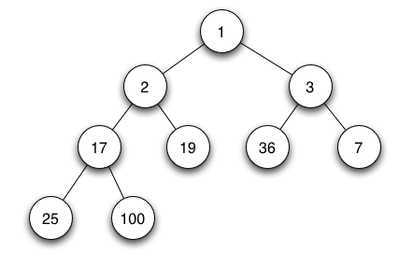
Notes:
Make them create one file from next time

Slide 11
What is the height of a complete binary tree?
Notes:
Trade off between having one efficient and one non efficient method…lets have a logn method for both

Slide 12
Complete Binary Tree
Add
Remove
Notes:
Talk about circular linked list

Slide 13
Priority Queues
Notes:
Make them create one file from next time

Slide 14
Priority Queues
Class PriorityQueue{
// accessor methods
int size();
bool isEmpty(); T min();
// update methods void insert(int priority, T value); void removeMin();
}
Notes:
Talk about circular linked list

Slide 15
How to implement a complete binary tree
Notes:
Array or our normal binary tree

Slide 16
How to implement Heap using CBT?
Min
Insertion
removeMin
Notes:
Talk about circular linked list

Slide 17
Heap Sort
Notes:
Make them create one file from next time

Slide 18
Heap Sort is O(nLogN)
Notes:
Sigma x^j = 1/1-x
Differentiate

Slide 19
Time to find top K elements?
Notes:
Sigma x^j = 1/1-x
Differentiate

Slide 20
Thank You!
Kartik Mathur

